Slide 1
Plant Form and Function

Slide 2
Chapter 34 Roadmap.
© 2017 Pearson Education, Ltd.
Notes:
Chapter 34 Roadmap.

Slide 3
Introduction
Plants make their own food through photosynthesis, using the energy from sunlight
They stay in one place, extending their roots and shoots to harvest diffuse resources
The structure of a plant’s body is dynamic, because most plants grow throughout their lives and exhibit indeterminate growth

Slide 4
Introduction
We will look at three fundamental questions, focusing on angiosperms:
How is the plant body organized?
Why are plants so diverse in size and shape?
How do plants grow throughout their lives?

Slide 5
Plant Form
Plants use light energy to synthesize carbohydrates from carbon dioxide in the air and water from the soil
Plants must also obtain nitrogen, phosphorus, potassium, magnesium, and other nutrients
These key elements exist in nature primarily as ions dissolved in soil water

Slide 6
How Is the Plant Body Organized?
Belowground, the root system anchors the plant and takes in water and nutrients from the soil
Aboveground, the shoot system harvests light and carbon dioxide from the atmosphere to produce sugars
Together, these systems make up the plant body

Slide 7
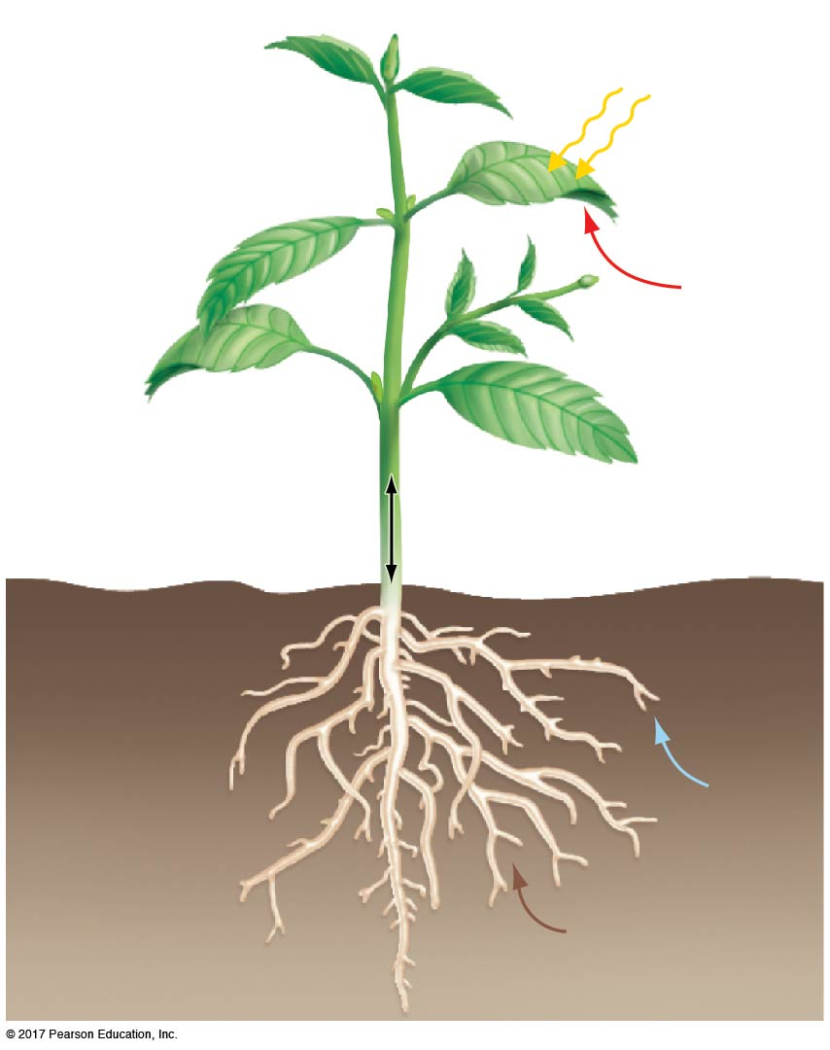
Figure 34.1
Apical bud
Sunlight
Node
Internode
Shoot system
Node
CO₂
Leaves
Axillary bud
Branch
Stem
Transport of water, sugar,
and nutrients through
vascular tissue
Lateral
roots
Root system
Water
Nutrients
(such as N, P, K)
Taproot
© 2017 Pearson Education, Ltd.
Notes:
Figure 34.1 Typical Root and Shoot Systems Acquire and Transport Resources.

Slide 8
Importance of Surface Area and Volume Relationships
Root and shoot systems both function in absorption
Roots absorb water and key nutrients
Shoots absorb light
Absorption takes place across a surface, but the cells that use the absorbed light and molecules occupy a volume
A plant is efficient in absorption if it has a large surface area relative to its volume

Slide 9
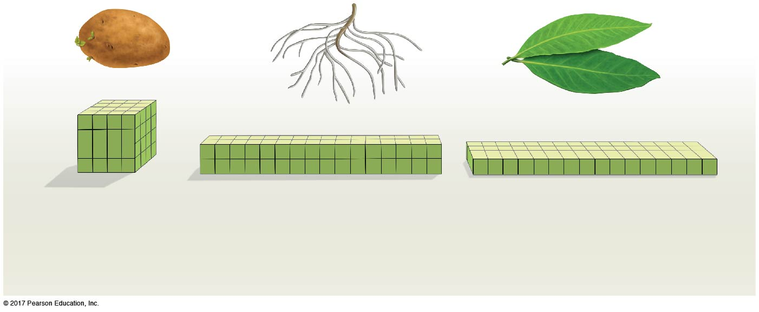
Figure 34.2
Thick structure (64 cells)
50 µm
Tubelike structure
Flattened structure
(64 cells)
(64 cells)
Surface area = 240,000 µm²
Surface area = 340,000 µm²
Surface area = 420,000 µm²
(96 cell surfaces x 2500 µm²/cell surface)
(136 cell surfaces x 2500 µm²/cell surface)
(168 cell surfaces x 2500 µm²/cell surface)
Volume = 8,000,000 µm³
Volume = 8,000,000 µm³
Volume = 8,000,000 µm³
(64 cells x 125,000 µm³/cell)
(64 cells x 125,000 µm³/cell)
(64 cells x 125,000 µm³/cell)
Surface area/volume = 0.0300/µm
Surface area/volume = 0.0425/µm
Surface area/volume =
?
© 2017 Pearson Education, Ltd.
Notes:
Figure 34.2 The Morphology of Roots and Leaves Gives Them a High Surface Area/Volume Ratio.

Slide 10
The Root System
Many root systems have a taproot and lateral roots
There are many key functions of the root system:
Roots anchor the plant to the soil
Roots absorb ions and water from soil
Roots conduct water and ions to the shoot system
Roots obtain energy from the sugar in the shoot system
Roots store molecules produced in the shoot system

Slide 11
The Root System
Although most root systems contain the same general structures, root systems are diverse
This diversity can be analyzed on three levels:
Morphological diversity among species
Phenotypic plasticity in response to the environment
Modified roots that are specialized for unusual functions

Slide 12
Morphological Diversity in Root Systems
Consider prairie plants
Prairies are grassland ecosystems that support many herbaceous plants
The root systems of prairie grasses are perennial, surviving fire or drought
A new shoot system is produced each spring or after fire
Prairie grasses show diversity among species, minimizing competition for water and resources

Slide 13
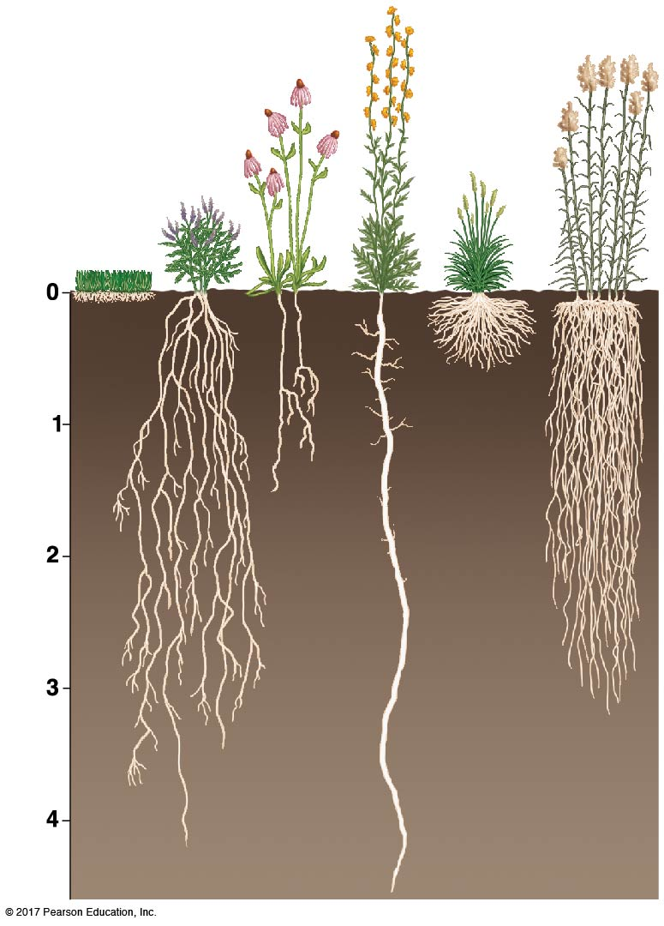
Figure 34.3
Compass
plant
Pale purple
coneflower
Switchgrass
Nonnative lawn
grass, for
comparison
Lead
plant
Junegrass
Depth (m)
Fibrous
roots
Taproot
© 2017 Pearson Education, Ltd.
Notes:
Figure 34.3 Plants Have Diverse Root Systems.

Slide 14
Phenotypic Plasticity in Root Systems
Morphological diversity in roots also occurs within species
Roots show phenotypic plasticity, with form that changes with environmental conditions
The environment can determine the type and depth of the root system
Roots die back in areas lacking resources
For example, spruce trees in waterlogged soils have shallow roots due to lack of oxygen

Slide 15
Modified Roots
Modified roots are formed by various types of plants
Adventitious roots grow from the shoot system
In ivy, adventitious roots act to anchor the plant
The prop roots of corn brace the plant
Root systems can produce modified roots
Mangroves produce pneumatophores for gas exchange
The taproots of beets and carrots store carbohydrates

Slide 16
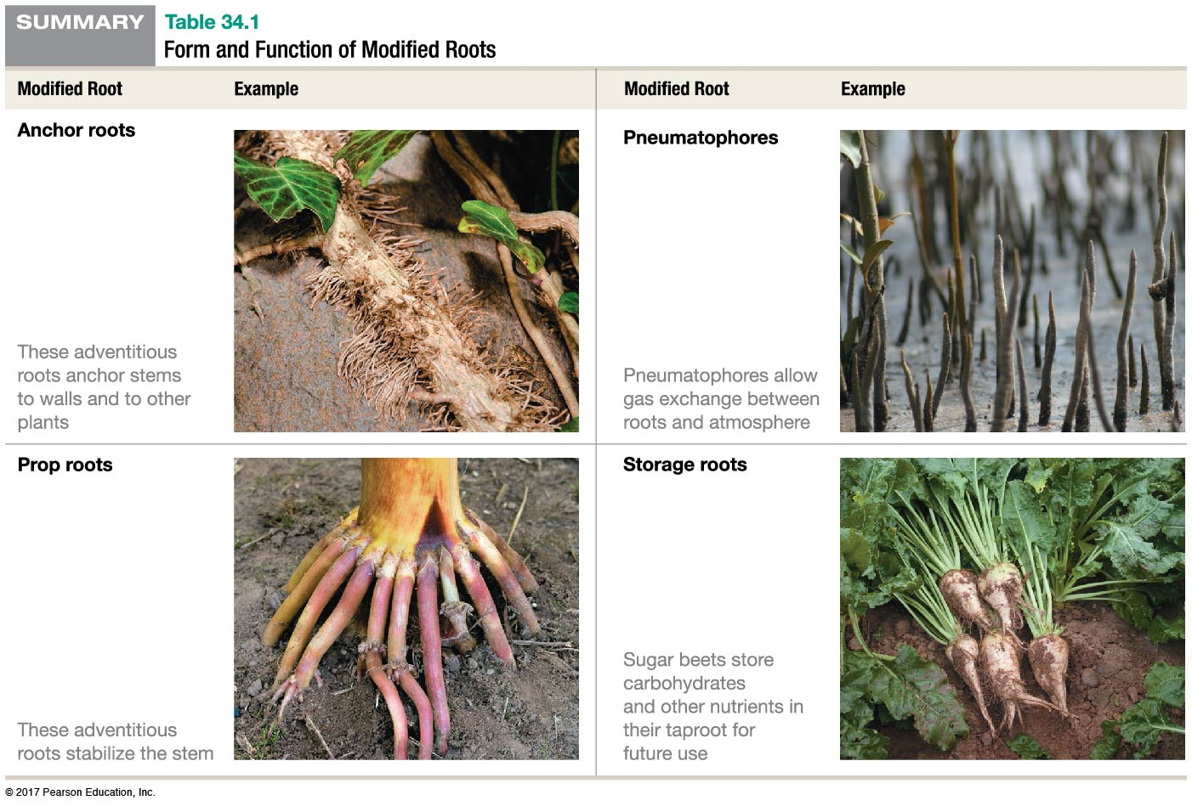
Table 34.1
© 2017 Pearson Education, Ltd.
Notes:
Table 34.1 Form and Function of Modified Roots.

Slide 17
The Shoot System
The shoot system has many anatomical features:
Stems are vertical aboveground structures consisting of nodes, where leaves are attached, and internodes, or segments between nodes
Axillary (or lateral) buds form at nodes just above the site of leaf attachment
An axillary bud may grow into a branch
The tip of each stem and branch contains an apical bud
Apical and axillary buds may develop into flowers

Slide 18
The Shoot System
Shoot diversity can also be analyzed on three levels:
Morphological diversity among species
Phenotypic plasticity within individuals
Modified shoots with specialized functions

Slide 19
Morphological Diversity in Shoot Systems
Shoot systems range in size from tiny duckweed (< 5 mm diameter) to giant redwood trees (100 m tall)
Variation in the size and shape of the shoot system of various species minimizes competition for light
Silversword plants native to Hawaii have shoot systems that are particularly diverse
Lush environments and competition for light favors taller shoot systems, while dry, windblown habitats favor short stems that are more anchored to the soil

Slide 20
Phenotypic Plasticity in Shoot Systems
The size and shape of a plant’s shoot system can vary based on variation in growing conditions: temperature, wind exposure, and availability of water, nutrients, and light
Genetically identical herbaceous plants were grown from cuttings taken from the same plant
The cuttings were grown at different elevations from sea level to alpine habitats, resulting in a variety of shoot systems

Slide 21
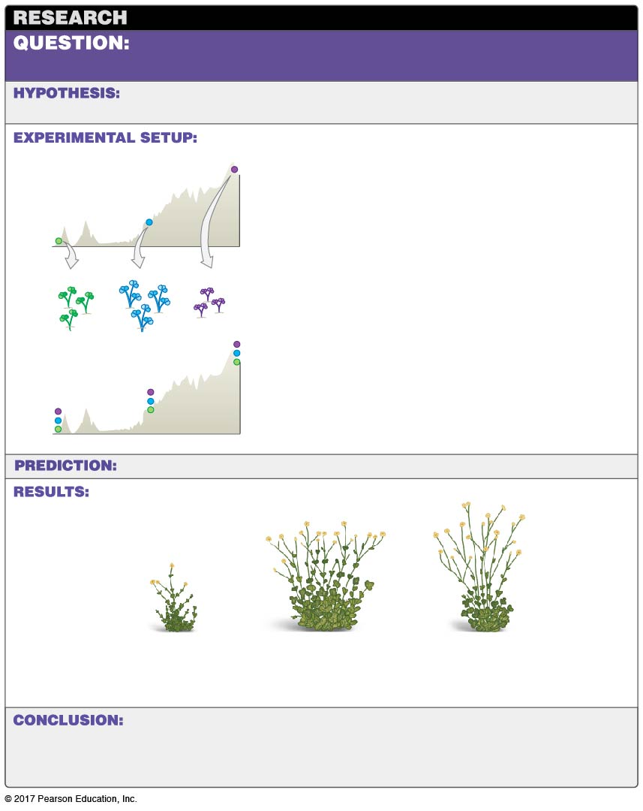
Figure 34.4
How much does a plant’s growth form depend on its
environment?
(No explicit hypothesis—the goal of this experiment was to explore the
interaction between genetic makeup versus environmental influence on size and shape.)
High
Medium
3000 m
1. Take cuttings from individuals of Potentilla
glandulosa growing in low-, medium-, and high-
elevation habitats in the Sierra Nevada mountains.
Low
2. Propagate genetically identical individuals.
3. Transplant individuals from each source
population into each habitat (low, medium,
and high elevation). Allow to grow and
observe mature plants.
(No explicit predictions.)
Examples of mature plants observed:
“High” plant
grown at
low elevation
“High” plant
grown at
medium elevation
“High” plant
grown at
high elevation
Environmental conditions have a profound influence on body size and
shape (genetically identical plants look different at each site). BUT, genetic makeup also has
a large influence on plant morphology. (Though not pictured here, plants from the different
source populations looked different, even when all were grown in the same habitat.)
© 2017 Pearson Education, Ltd.
Notes:
Figure 34.4 Experimental Evidence Supports Phenotypic Plasticity in Shoot Systems.

Slide 22
Modified Stems
Stems of many plants serve specialized functions
Cactus stems are modified to store water and for photosynthesis
Stolons are modified stems that grow horizontally, producing adventitious roots and leaves at each node
Rhizomes are stems that grow horizontally and function in asexual reproduction
Tubers are underground, swollen rhizomes that function as carbohydrate-storage organs
Thorns are modified stems that protect plants

Slide 23
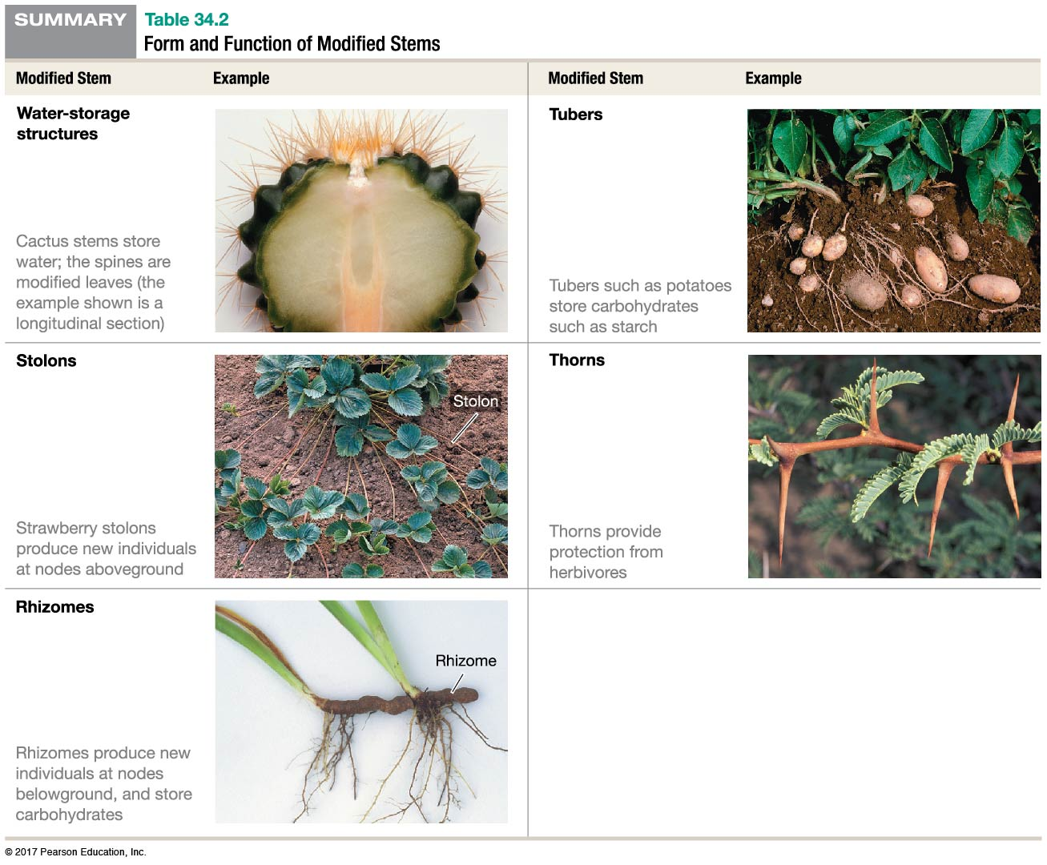
Table 34.2
© 2017 Pearson Education, Ltd.
Notes:
Table 34.2 Form and Function of Modified Stems.

Slide 24
The Leaf
The vast majority of photosynthesis occurs in leaves
The leaf’s relatively large surface area is available for absorbing photons and supporting photosynthesis
A simple leaf has two main structures, an expanded blade and a stalk called a petiole
In a compound leaf, the blade is divided into a series of leaflets
Needlelike leaves reduce water loss by transpiration

Slide 25
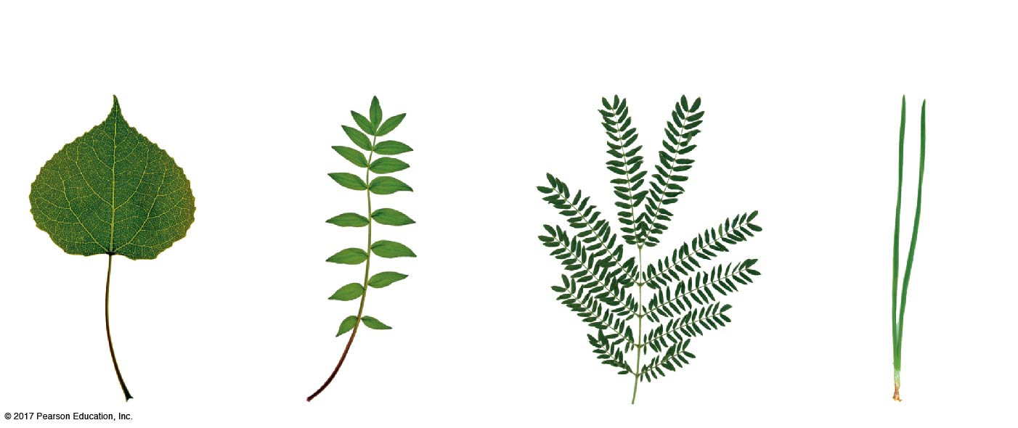
Figure 34.5
(a) A simple leaf has a
petiole and a single blade.
(b) A compound leaf has
a blade divided into leaflets.
(c) A doubly compound leaf is
large yet rarely damaged by wind
or rain.
(d) Needlelike leaves are
characteristic of species
adapted to very cold or
hot climates.
Blade
Petiole
© 2017 Pearson Education, Ltd.
Notes:
Figure 34.5 Leaves Vary in Size and Shape.

Slide 26
Morphological Diversity in Leaves
Not all leaves are thin, with a large surface area
Plants that thrive in deserts and in cold, dry habitats tend to have small, needlelike leaves, interpreted as adaptations to minimize transpiration in water-scarce habitats
Two observations support this hypothesis:
Water is scarce in deserts and frozen (and thus unavailable) in cold habitats
Leaves with a large surface area lose large amounts of water through transpiration

Slide 27
Morphological Diversity in Leaves
The arrangement of leaves on a stem may vary
Leaves may
Alternate on either side of the stem
Pair opposite each other on the stem
Be arranged in a whorl
Form a compact basal arrangement where internodes are extremely short—leading to a rosette growth form

Slide 28
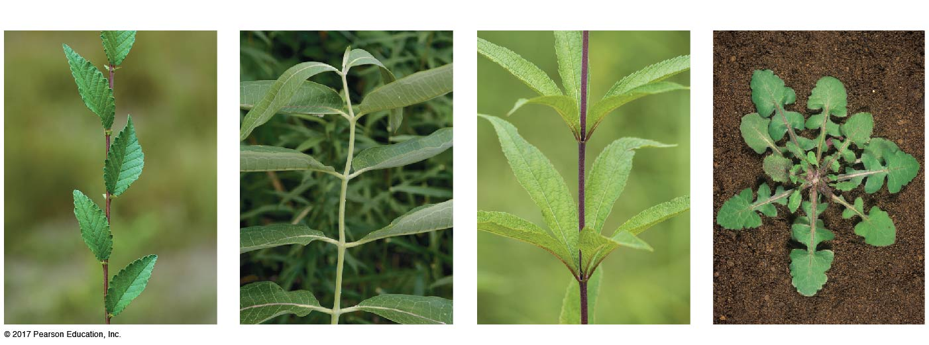
Figure 34.6
(a) Alternate leaves
(b) Opposite leaves
(c) Whorled leaves
(d) Rosette
© 2017 Pearson Education, Ltd.
Notes:
Figure 34.6 The Arrangement of Leaves on Stems Varies.

Slide 29
Phenotypic Plasticity in Leaves
Although leaves do not grow continuously, they do exhibit phenotypic plasticity
Oak tree leaves vary depending on the amount of sunlight they are exposed to:
Sun leaves have a relatively small surface area, reducing water loss in areas of the body where light is abundant
Shade leaves are relatively large and broad, providing a high surface area to maximize photon absorption

Slide 30
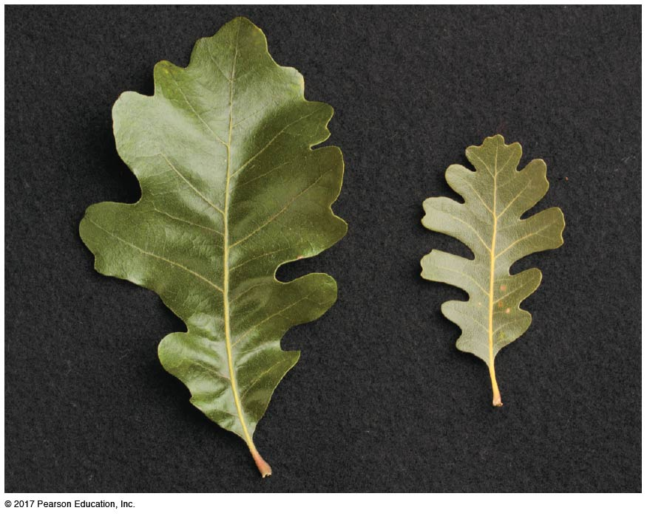
Figure 34.7
Grown
in shade
Grown
in sun
Notes:
Figure 34.7 Leaves Exhibit Phenotypic Plasticity.

Slide 31
Modified Leaves
Onion bulbs store nutrients
The leaves of succulents store water
Tendrils enable vines to climb
The bright red leaves of poinsettias attract pollinators
The tubelike leaves of the pitcher plant trap insects
Cactus spines protect the stem

Slide 32
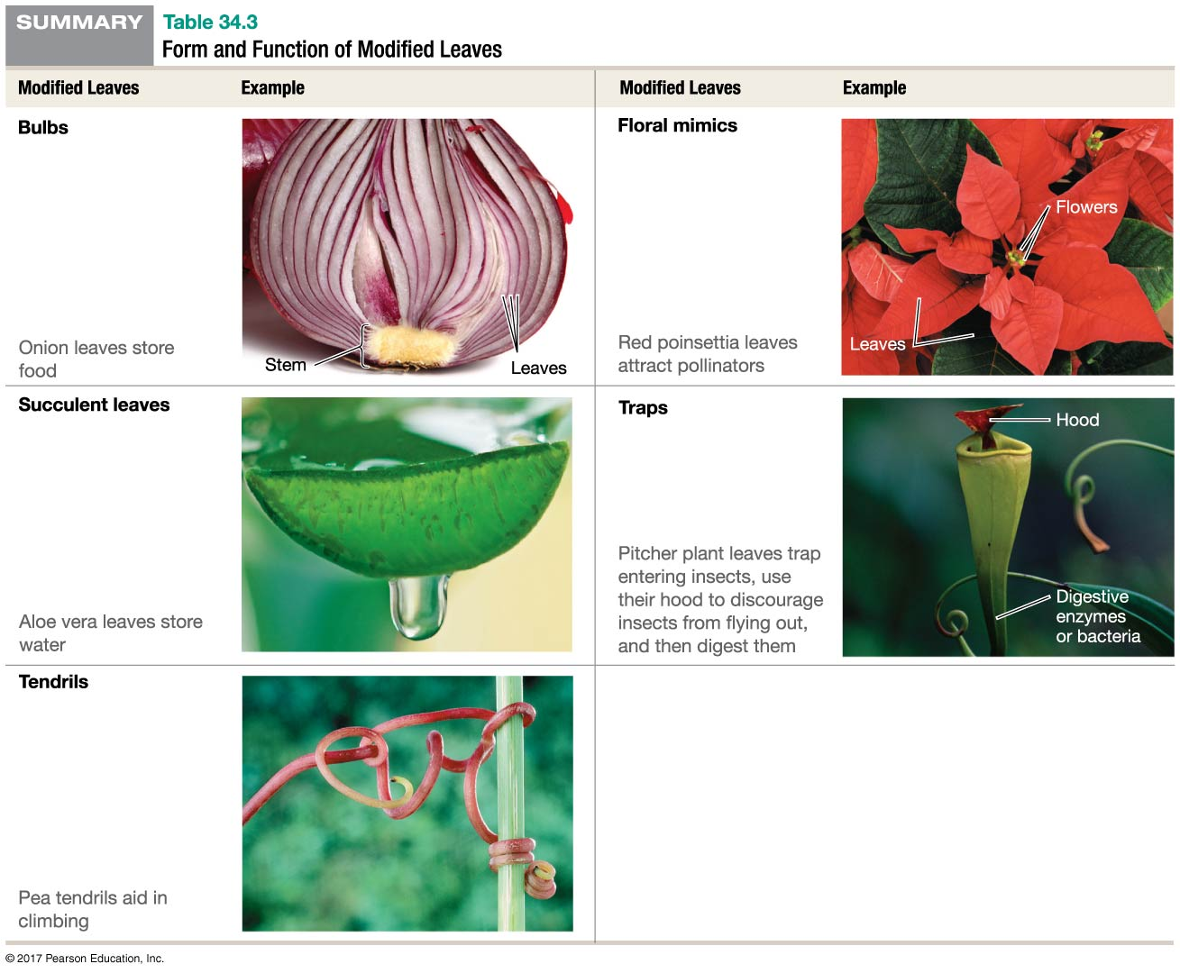
Table 34.3
© 2017 Pearson Education, Ltd.
Notes:
Table 34.3 Form and Function of Modified Leaves.

Slide 33
Plant Cells
Although eukaryotic cells share many key features, plant cells have several features not found in animal cells
Plant cells are surrounded by a cellulose-rich primary cell wall
Some plant cells have a rigid secondary cell wall
Plant cells are connected by plasmodesmata

Slide 34
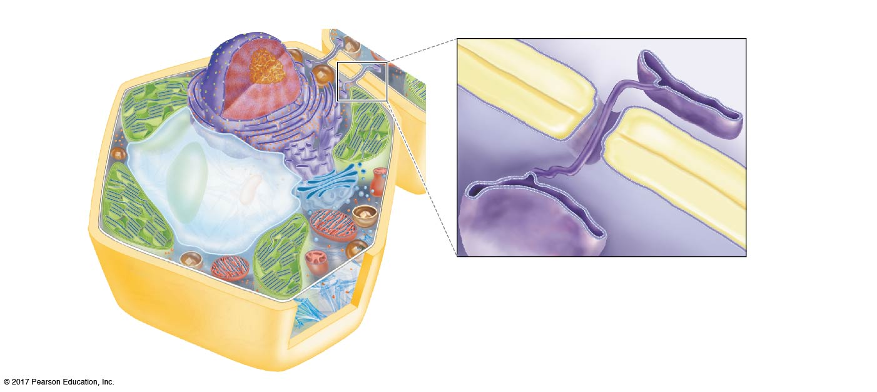
Figure 34.8
(a) Plant cells have cell walls, vacuoles, and chloroplasts.
(b) Adjacent plant cells are connected by plasmodesmata.
Cell 2
Smooth ER
Cell wall
Plasmodesma
Plasma
membrane
Plasma membrane
Cell 1
Cell wall
Vacuole
Cell wall
Plasma membrane
Chloroplast
Mitochondrion
Rough endoplasmic reticulum
Smooth endoplasmic reticulum
Golgi apparatus
Notes:
Figure 34.8 A Plant Cell Is Both Similar to and Different from an Animal Cell.

Slide 35
Plant Cells
Plant cells may contain chloroplasts and a large vacuole that fills most of the cell’s volume
Chloroplasts are the site of photosynthesis
Non-photosynthetic cells may have organelles that are similar to chloroplasts, but modified for storage of pigments, starch, oil, or proteins
Vacuoles contain an aqueous solution called cell sap and store waste, water, and nutrients

Slide 36
Plant Tissue Systems
Plant tissues are grouped into tissue systems, based on their structural features and location within the plant
Simple tissues consist of a single cell type; complex tissues contain several types of cells
Three tissue systems are found in plants:
The dermal tissue system
The ground tissue system
The vascular tissue system

Slide 37
The Dermal Tissue System
Dermal tissue is made up of several different cell types and thus represents a complex tissue
Epidermal cells protect the surface of the plant
They secrete a waxy cuticle to reduce water loss and protect against pathogens
Stomata regulate gas exchange and water loss
A stoma is surrounded by two specialized guard cells, which change shape to open and close the stoma

Slide 38
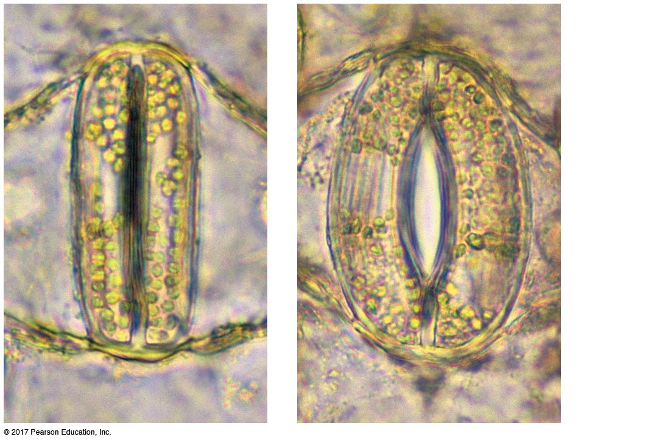
Figure 34.9
Guard
cells
Pore
10 µm
Stoma closed
Stoma open
© 2017 Pearson Education, Ltd.
Notes:
Figure 34.9 A Stoma’s Guard Cells Regulate the Opening of a Pore.

Slide 39
Trichomes Perform an Array of Functions
Trichomes are hairlike appendages made up of specialized epidermal cells that perform various functions:
They keep the plant’s surface cool by reflecting sunlight
They reduce water loss by limiting transpiration
They provide barbs or toxins to protect from herbivores
They trap and digest insects

Slide 40
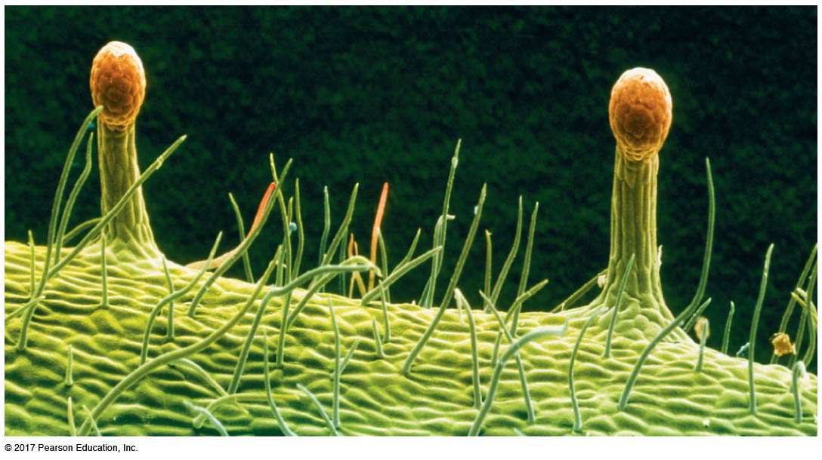
Figure 34.10
200 µm
© 2017 Pearson Education, Ltd.
Notes:
Figure 34.10 Epidermal Cells Produce Trichomes That Provide Protection.

Slide 41
The Ground Tissue System
Most photosynthesis and carbohydrate storage takes place in the ground tissue system
Ground tissue is a complex tissue made up of three distinct tissues:
Parenchyma
Collenchyma
Sclerenchyma

Slide 42
Parenchyma Consists of “Workhorse” Cells
Parenchyma is a simple tissue
Parenchyma cells have relatively thin primary cell walls
They are the most abundant and versatile plant cells
In leaves, parenchyma tissue is the primary site of photosynthesis
In roots, parenchyma cells store starch granules

Slide 43
Parenchyma Consists of “Workhorse” Cells
Many parenchyma cells are totipotent, retaining the capacity to divide and develop into a complete plant
This allows the plant to heal wounds and reproduce asexually
The totipotency of parenchyma cells allows gardeners to clone plants by making cuttings
The parenchyma cells form a mass of undifferentiated cells called a callus
Roots develop from the callus, and the new individual can be planted in soil

Slide 44
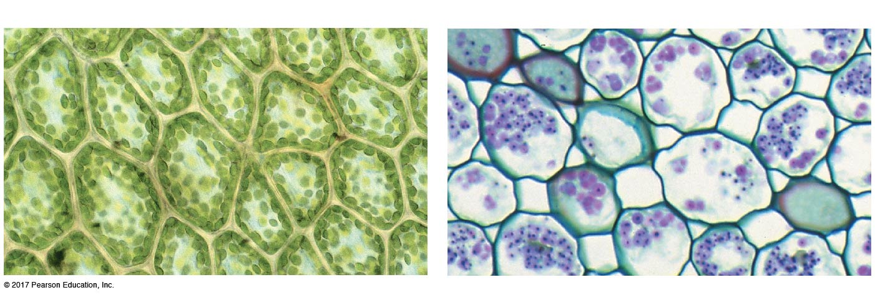
Figure 34.11
(a) In leaves: photosynthesis and gas exchange
(b) In roots: carbohydrate storage
Chloroplasts
25 µm
Starch granules
(stained purple)
25 µm
Notes:
Figure 34.11 Parenchyma Cells Perform a Wide Array of Tasks.

Slide 45
Collenchyma Functions Primarily in Shoot Support
Collenchyma is a simple tissue
Collenchyma cells have unevenly thickened primary cell walls and provide flexible structural support to actively growing parts of the plant
Collenchyma is often found just under the epidermis of stems, especially outside vascular bundles

Slide 46
Figure 34.12
(a) Cross section of celery stalk
(b) Close-up of “string,” in cross
section
(c) Collenchyma cells, in cross section
One cell
Cytoplasm
Cell wall
100 µm
10 µm
Notes:
Figure 34.12 Collenchyma Cells Support Growing Tissues.

Slide 47
Sclerenchyma: Two Types of Specialized Support Cells
The cells of sclerenchyma tissue have a thin primary cell wall and a thick, rigid secondary cell wall
The secondary cell wall contains tough, rigid lignin as well as cellulose
Sclerenchyma is a complex tissue with two types of cells:
​Fibers are elongated
​Sclereids are short, with variable shapes, and function in protection

Slide 48
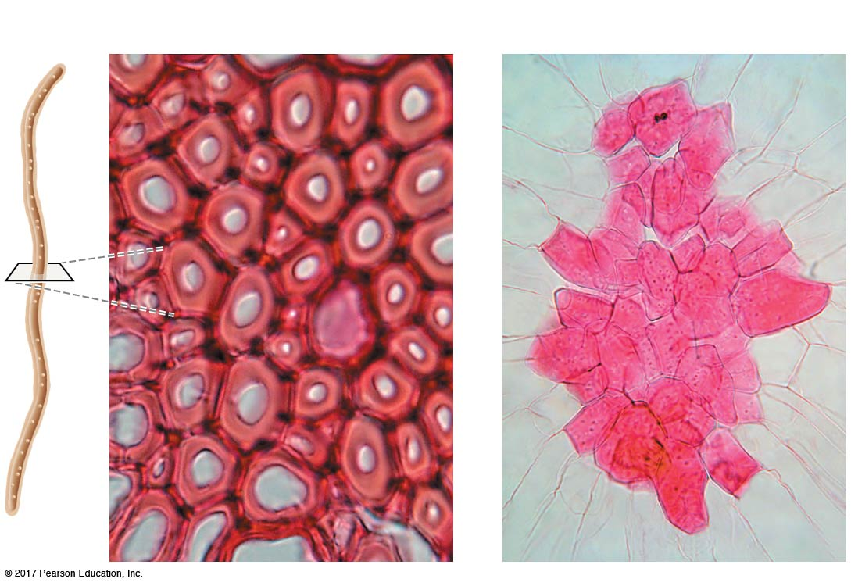
Figure 34.13
(a) Fibers
(b) Sclereids
20 µm
50 µm
Notes:
Figure 34.13 Sclerenchyma Cells Support Mature Tissues.

Slide 49
The Ground Tissue System
Schlerenchyma and collenchyma cells differ
Collenchyma cells have expandable primary cell walls and support growing tissue in stems
Sclerenchyma cells are dead at maturity and function to support stems and other structures after growth has ceased

Slide 50
The Vascular Tissue System
The vascular tissue system is made up of two complex tissues: xylem and phloem
Xylem conducts water and dissolved nutrients from the root system to the shoot system
Phloem conducts sugars, amino acids, hormones, and other substances from roots to shoots and from shoots to roots

Slide 51
Xylem Structure
Xylem is a complex tissue containing water-conducting cells, parenchyma cells, and fibers
There are two types of water-conducting cells:
The xylem of all vascular plants contains tracheids with pits through which water moves
In angiosperms, xylem also contains vessel elements with perforations for water transport

Slide 52
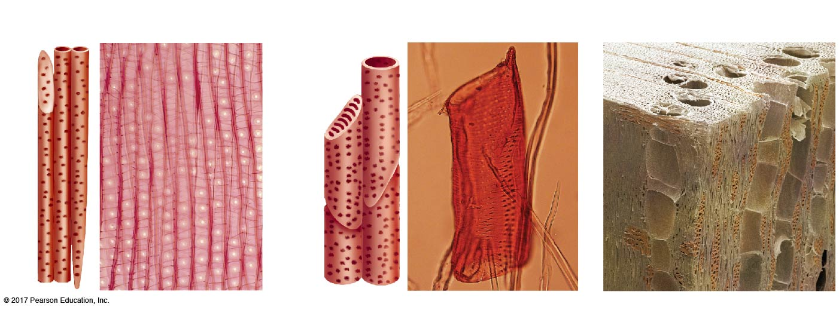
Figure 34.14
(a) Tracheids are long, tapered,
and have pits.
(b) Vessel elements are short and wide
and have perforations as well as pits.
(c) Tracheids and vessel elements
are found together in vascular tissue.
Pits
Perforations
Pits
Pits
25 µm
50 µm
100 µm
Tracheids
Vessel
elements
© 2017 Pearson Education, Ltd.
Notes:
Figure 34.14 Xylem May Contain Two Types of Water-Conducting Cells.

Slide 53
Phloem Structure
Phloem is a complex tissue containing two types of specialized cells:
​Sieve-tube elements are long, thin cells with perforated ends called sieve plates
​Companion cells maintain the cytoplasm and plasma membrane of sieve-tube elements
Sieve-tube elements lack nuclei and are directly connected to adjacent companion cells by plasmodesmata

Slide 54
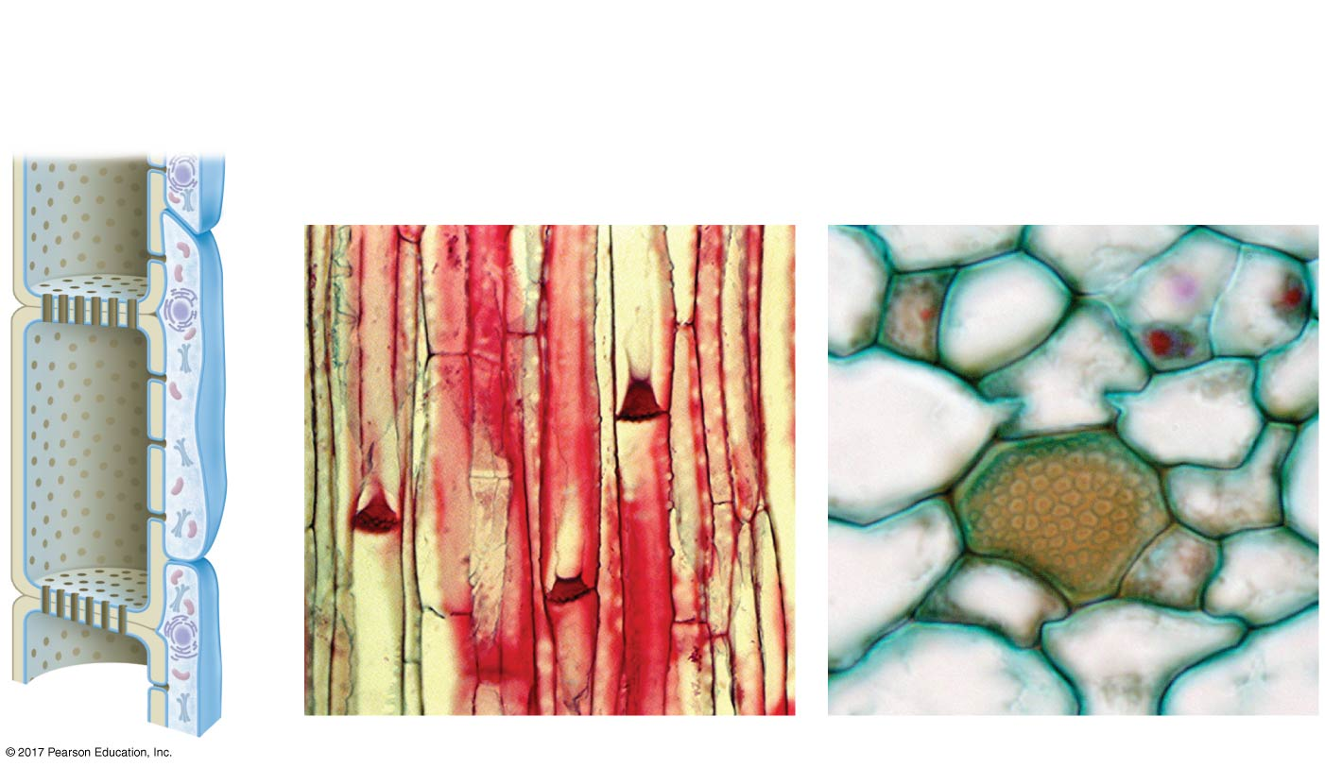
Figure 34.15
Sieve-tube
element
(few
organelles)
Companion
cell
(many
organelles)
Longitudinal section
Cross section
Sieve
plate
Companion
cell
Sieve plate
Sieve plate
Companion
cell
50 µm
25 µm
© 2017 Pearson Education, Ltd.
Notes:
Figure 34.15 Phloem Consists of Sieve-Tube Elements and Companion Cells.

Slide 55
Primary Growth Extends the Plant Body
Plants grow throughout their lives because they have many meristems—populations of undifferentiated cells that retain the ability to undergo mitosis
Apical meristems are found at the tip of each root and shoot and are responsible for primary growth
The cells and tissues derived from apical meristems make up the primary plant body

Slide 56
Primary Growth Extends the Plant Body
Apical meristems give rise to three distinct primary meristems:
​Protoderm gives rise to the dermal tissue system
​Ground meristem gives rise to the ground tissue system
​​Procambium gives rise to the vascular tissue system

Slide 57
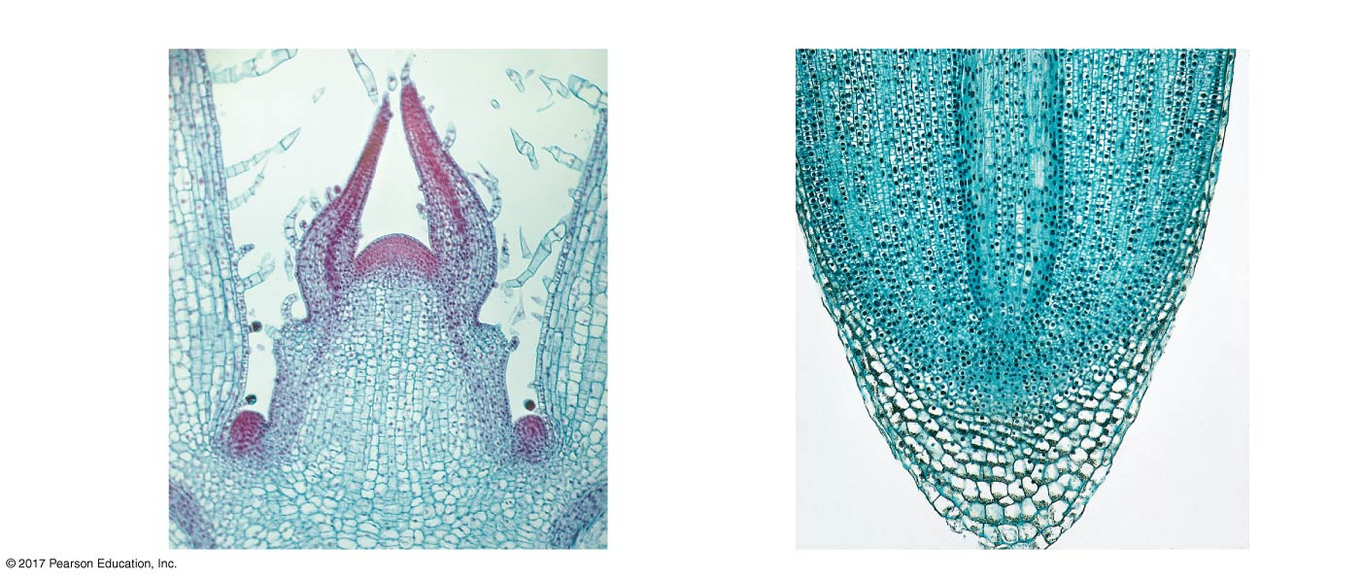
Figure 34.16
(a) Apical and primary meristems in a shoot
(b) Apical and primary meristems in a root
Primary
meristems:
Newly
forming
leaves
Procambium
Apical
meristem
at tip of
shoot
Protoderm
Apical
meristem
at tip of
root
Apical
meristem
in axillary
bud
Ground
meristem
100 µm
300 µm
© 2017 Pearson Education, Ltd.
Notes:
Figure 34.16 The Apical and Primary Meristems in the Shoot and Root Give Rise to Plant Tissues.

Slide 58
How Is the Primary Root System Organized?
The root apical meristem is protected by a group of cells called the root cap
Cells produced by the meristem constantly replenish the cap, which regularly loses cells
The root cap also senses gravity to determine the direction of growth and secretes a slimy lubricant to reduce friction as the apical meristem is pushed through soil

Slide 59
How Is the Primary Root System Organized?
Three distinct populations of cells are found behind the root cap:
The zone of cellular division contains the apical meristem, as well as the protoderm, ground meristem, and procambium
Cells in the zone of cellular elongation increase in length
Cells in the zone of cellular maturation differentiate into dermal, vascular, or ground tissue, and absorb water and nutrients through root hairs

Slide 60
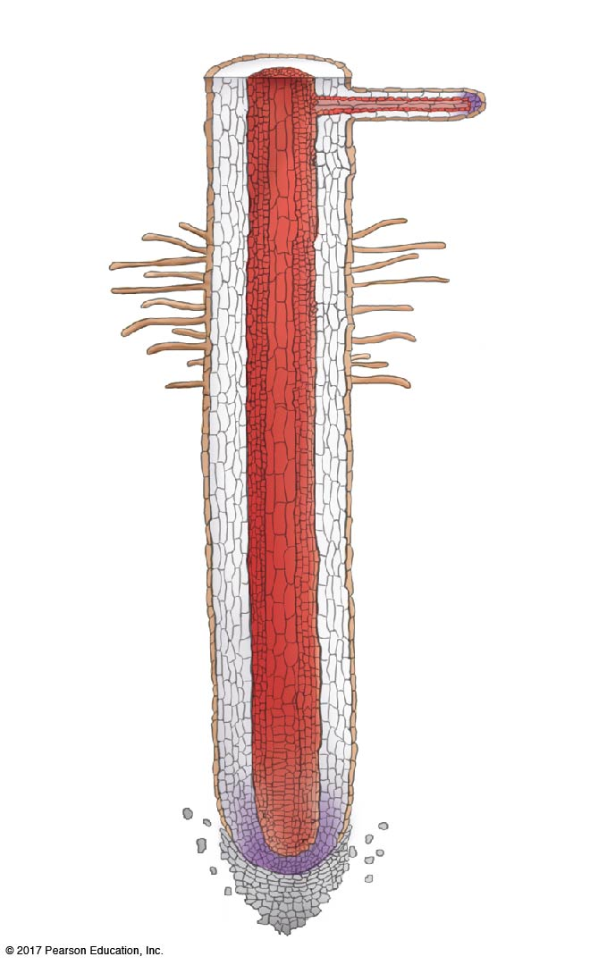
Figure 34.18a
(a) Longitudinal section of a root
Lateral
root
Zone of
cellular maturation
Root hairs
Zone of
cellular elongation
Vascular tissue
Ground tissue
Epidermal tissue
Zone of
cellular division
Apical meristem
Sloughed-off
root cap cells
Root cap
© 2017 Pearson Education, Ltd.
Notes:
Figure 34.18a Roots Extend into the Soil via Growth of Apical Meristems and Cell Elongation.

Slide 61
How Is the Primary Shoot System Organized?
The arrangement of vascular bundles and ground tissue in the stem differs between monocots and eudicots
In a eudicot, vascular bundles are arranged in a ring near the stem’s perimeter
Ground tissue is divided into the central pith and the outer cortex
In a monocot, vascular bundles are scattered through the ground tissue

Slide 62
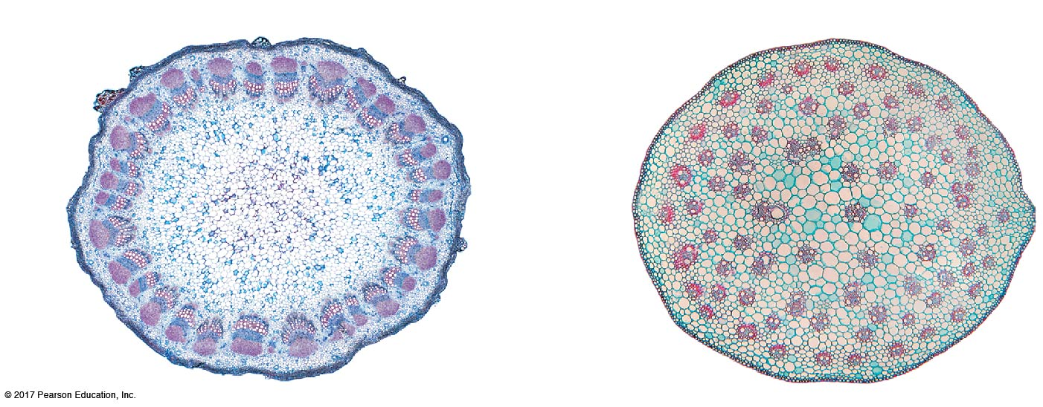
Figure 34.19
(a) Cross section of a eudicot stem
(b) Cross section of a monocot stem
Epidermis
Cortex
Ground
tissue
Pith
Fibers
Phloem
Vascular
bundles
Xylem
1 mm
0.5 mm
© 2017 Pearson Education, Ltd.
Notes:
Figure 34.19 Tissue Systems in Stems Have Distinct Arrangements.

Slide 63
Secondary Growth Widens Shoots and Roots
Secondary growth increases the width of roots and shoots, increasing the amount of conducting tissue available and providing increased structural support
Secondary growth produces wood and occurs in species that have a cambium in addition to apical meristems

Slide 64
What Is a Cambium?
A cambium differs from an apical meristem
It forms a cylinder that runs the length of the root, trunk, or branch
Its cells divide to increase the width of the plant
There are two types of cambia in plants:
​Vascular cambium is located between secondary xylem and secondary phloem
​Cork cambium is located near the outer perimeter of the root, trunk, or branch

Slide 65
How Does a Cambium Initiate Secondary Growth?
In the stem of a woody eudicot, a single layer of cells between the xylem and phloem becomes meristematic and forms the vascular cambium
Another ring of cells under the epidermis becomes meristematic and forms the cork cambium
Each cambium produces secondary growth each year
Secondary growth occurs in a similar fashion in roots

Slide 66
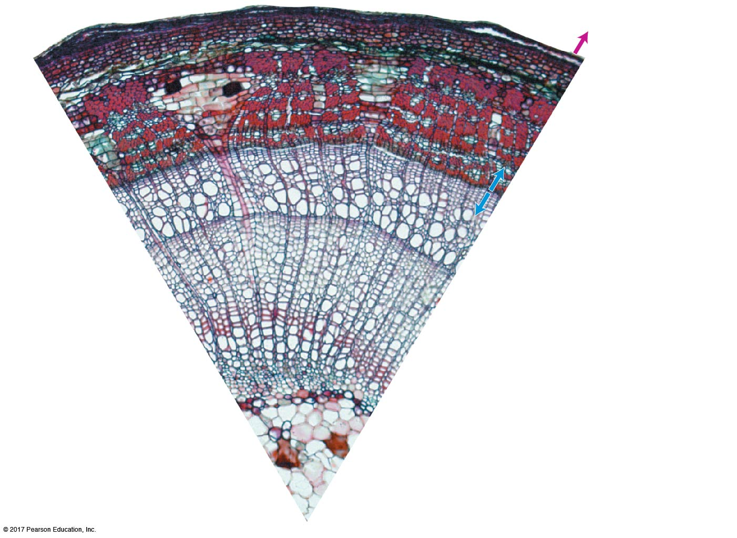
Figure 34.20
Cork
Growth
Phloem
rays
Cork cambium
Cortex
Primary phloem
Bark
Secondary phloem
Growth
Xylem
rays
Vascular cambium
Wood
Secondary xylem
Primary xylem
200 µm
Pith
Notes:
Figure 34.20 Cambia Are Responsible for Secondary Growth.

Slide 67
What Do Vascular Cambia Produce?
Vascular cambia in roots and stems produce the secondary xylem and secondary phloem
Secondary xylem makes up wood, while secondary phloem makes up the inner part of the tree’s bark
Vascular cambium also produces sclerenchyma fibers and parenchyma cells, formed in lateral rows of cells called rays
Production of these tissues is highly asymmetrical with creation of more secondary xylem, which is retained and accumulates as wood

Slide 68
What Do Cork Cambia Produce?
Cork cambium produces cork cells to the exterior of the trunk
Secondary phloem, cork cambium, and cork cells make up the bark of a tree trunk
Gas exchange occurs through small openings called lenticels

Slide 69
The Structure of a Tree Trunk
The older, innermost secondary xylem accumulates protective compounds such as resins and gums
Dark-colored, inner xylem is called heartwood while light-colored, outer xylem is called sapwood
In areas with seasonality, the vascular cambium stops growing during the dry or cold season
This results in the formation of annual tree rings, with alternating early and late wood

Slide 70
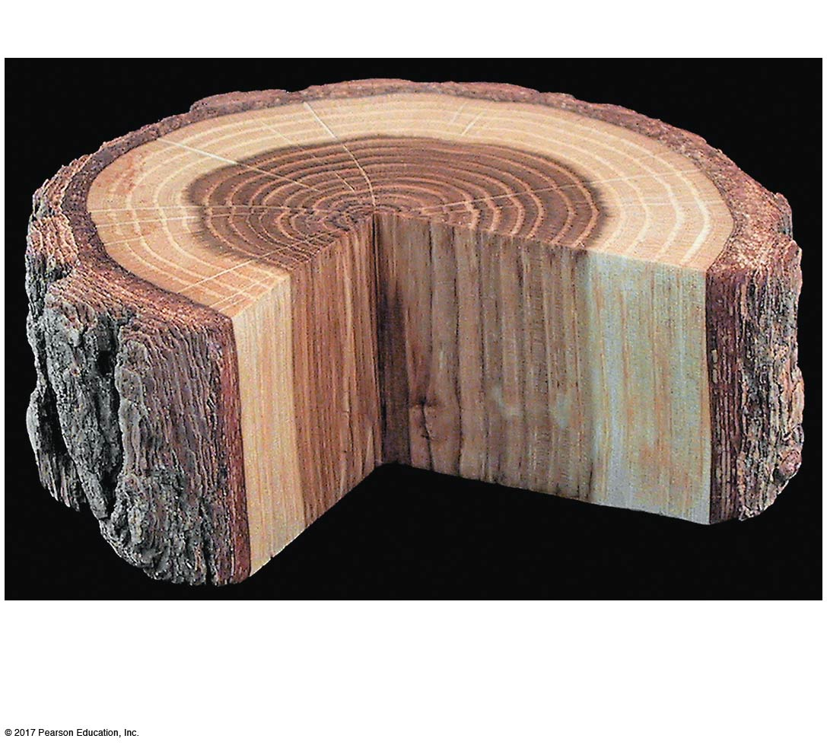
Figure 34.23a
(a) Heartwood and sapwood have different functions.
Vascular
cambium
Heartwood
Sapwood
Bark
Provides structural
support but no longer
transports water
Includes active
water-conducting
xylem tissue
Notes:
Figure 34.23a Anatomy of a Tree Trunk.

